Slide 1
Week 4 – Pitch, Coding Interview, Careers, GitHub
Lot’s of information to consume this week
Feb. 10, 2023

Slide 2
Topics for Today
LinkedIn, Pitch and Networking – Ellie Evans
Careers – Emerging and Other Options
Coding Interviews
GitHub

Slide 3
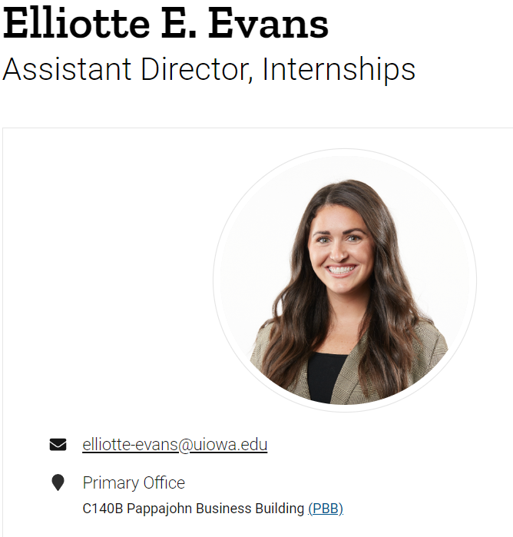

Slide 4
Networking, LinkedIn and Tips
Ellie Evans, Assistant Director of Internships

Slide 5
Credibility and Brand
I come with 3 years of industry expertise, as in my previous role, I was at the Cedar Rapids Metro Economic Alliance. Economic Alliance is a 501c6 nonprofit organization that supports businesses through economic development & workforce, community development, and public policy initiatives.
Workforce Specialist:
Talent attraction & retention
Largest talent attraction marketing campaign for ICR Iowa
Assisted with business attraction projects
Local resource for all things employment at the State level
Managed the largest internship program called IgniteICR
Liaison for many other boards and projects

Slide 6

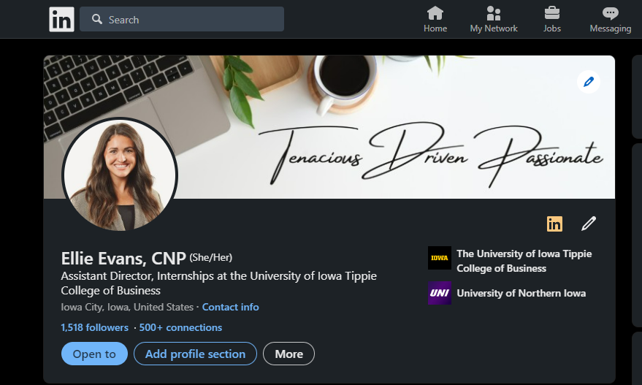
LinkedIn
Make sure your profile is up to date
Picture of you, banner, who you are, what you’re seeking
Summary of you
Experience & education (degree, not major)
Utilize your LinkedIn like your personal contact book
Handshake
Recruiter is listed on the posting
Reach out to recruiter via LinkedIn
Connect with faculty and staff
1st connections become your 2nd
Personal LinkedIn
Recruiters want to help you

Slide 7

Networking
It’s simple
That person
Pets
Family
Weather
Work – “how’s business”
Always be on – authentically you
Introverts
You can step away
Quality over quantity
Time
Conversations
Food and drink
Handshake with a nametag
Dress
Comfort level

Slide 8

Tips & Tricks
Advice from one young professional to the next young professional:
An interview goes 2 ways, always ask in-depth questions
Always ask questions, never assume. People want to help you (this helps with imposter syndrome)
Always raise your hand when it comes to helping your team out (within reason)
Stay up to date on:
Local and national news
Sports
Industry
Get involved in your community

Slide 9
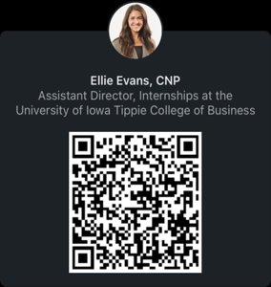
Connect with me

Slide 10
Careers
Emerging and Other Paths

Slide 11
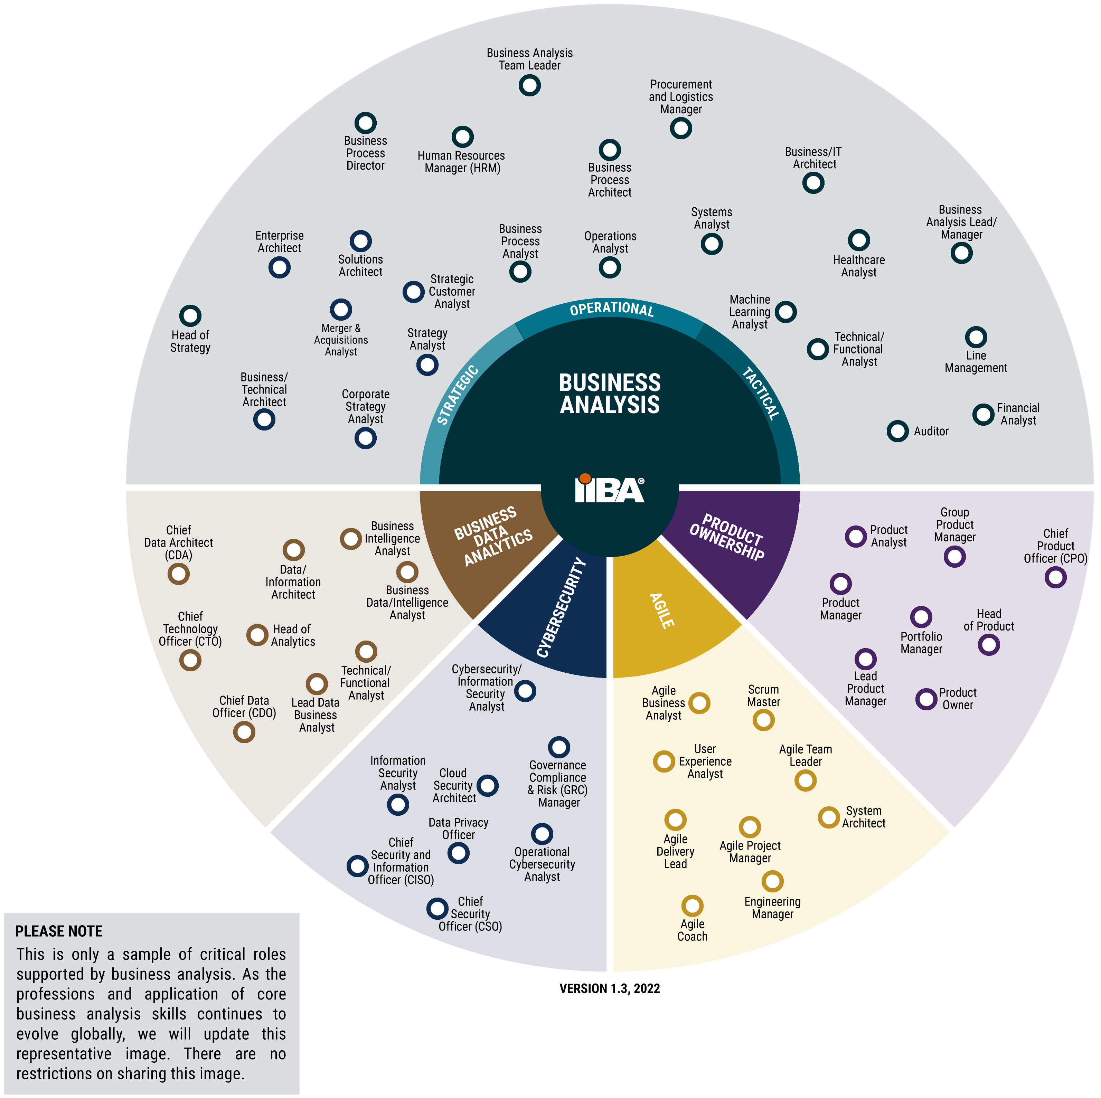

Slide 12
Emerging Roles
Cybersecurity
Crypto or Blockchain Analysts (https://cryptocurrencyjobs.co/data/ )
Healthcare Analytics
Cloud Computing
Supply Chain or Logistics Analyst
Operations Analyst

Slide 13
Coding Interviews

Slide 14

Why Coding Interview?
Demonstrate first-hand evidence of coding skills
Recruiting is expensive - find ways to streamline
Filters applicants quickly
Shows applicants coding and thought process
Reduces bias

Slide 15



Coding Question Practice - Websites
HackerRank (show example)
Coderbyte
Leetcode

Slide 16
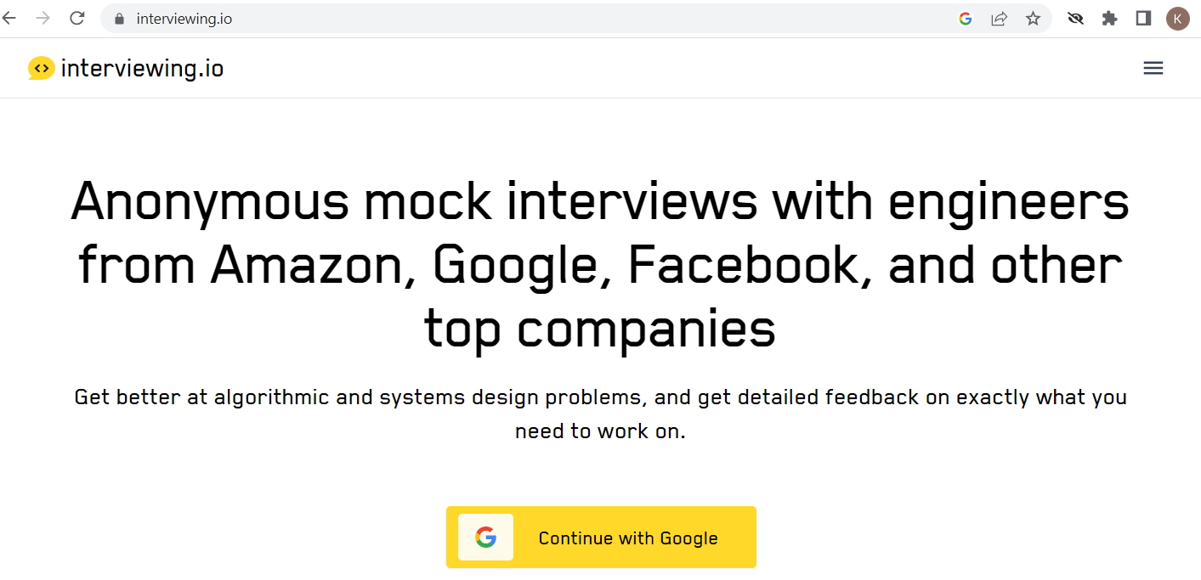
Coding Feedback – using Interviewing.io

Slide 17
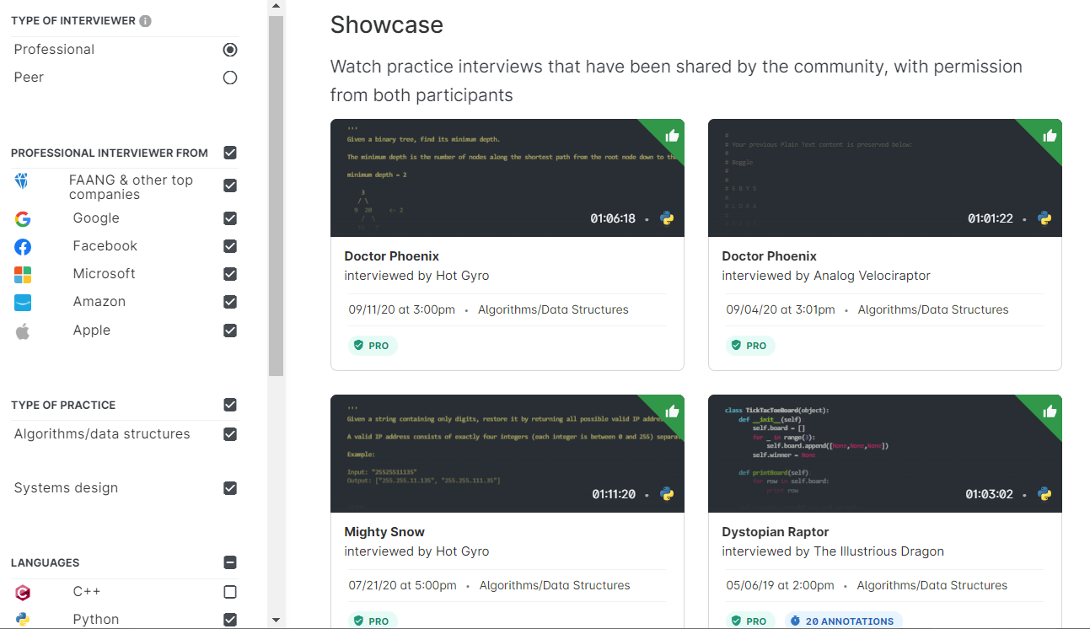
Real Practice Coding Interview (interviewing.io)
Interested in Big Tech Companies
Google
Facebook
Microsoft
Amazon
Apple
Consider using this!

Slide 18
GitHub

Slide 19

What is GitHub
A really cute cat octopus?
Open-source repository for storing software code
Allows tracking of iterations (version control)
Collaboration tool
AND…A GREAT WAY TO SHOWCASE YOUR SKILLS TO EMPLOYERS

Slide 20
Getting Started
GitHub and Git Basics Video
Learn more through:
LinkedIn Learning – Free to U of Iowa students
lab.github.com
Upload source code and project samples
Add GitHub public link to your resume

Slide 21
GitHub Page Samples
Kris Arens: https://github.com/kristinearens
Canny Li Page: https://mobius21.github.io/markdown-portfolio/
Zach McDaniel: https://zachmcdaniel.github.io/
Chad Nelson’s Page: https://chad-nelson.github.io/

Slide 22
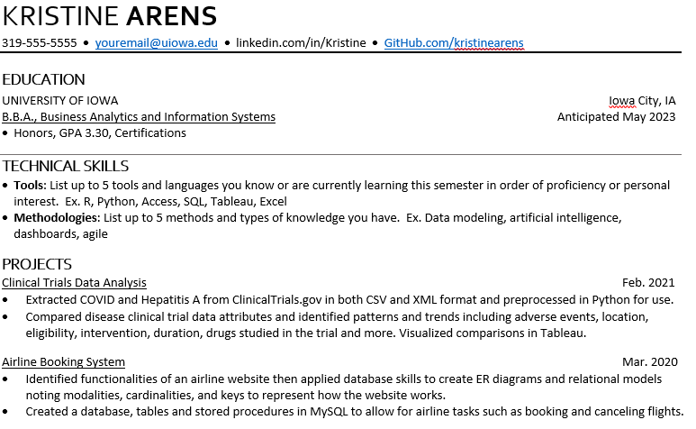
GitHub on Resumes
Showcase your work
Match repository to projects
Provide:
Code examples
Presentations
Data Analysis

Slide 23
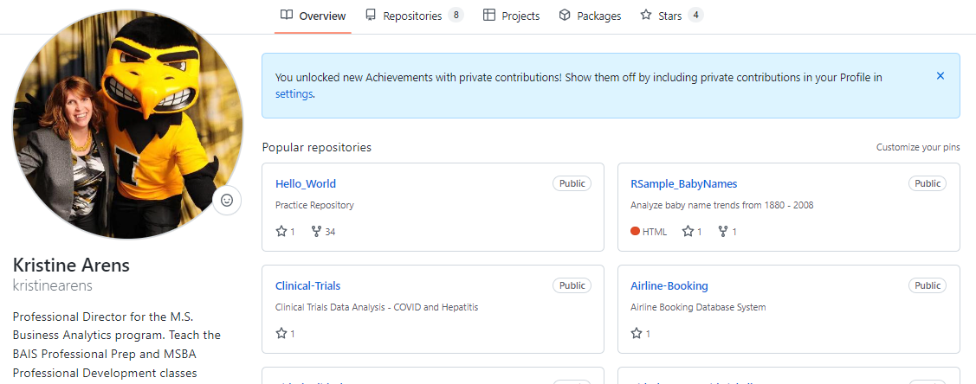
Let’s Take a Look
https://github.com/kristinearens

Slide 24
Assignment

Slide 25
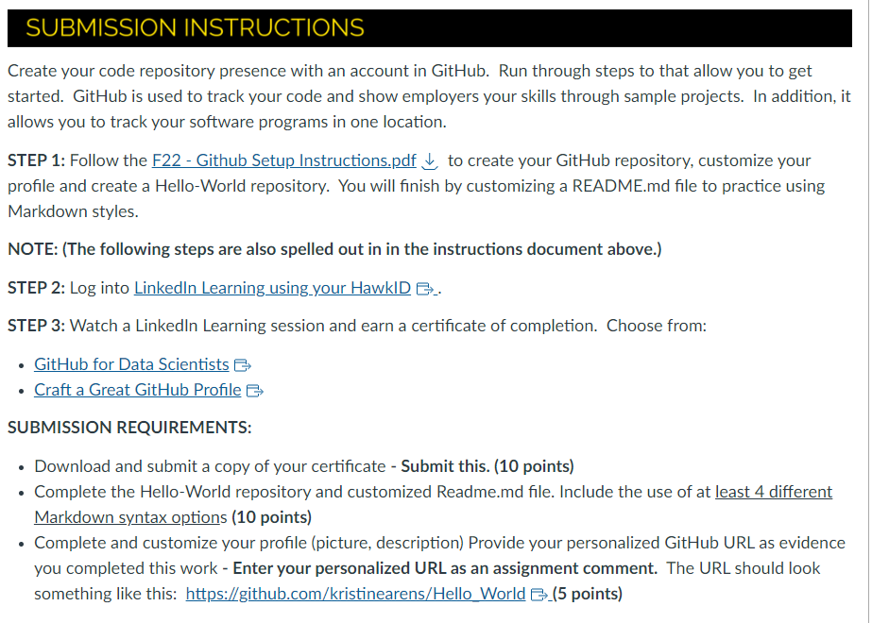
Assignment – GitHub (REQUIRED)

Slide 26
Next Week
Case Interview and Negotiating Your Offer

